Slide 1


Parallel Processing
With 8 Raspberry Pis
Bob Laskowski, Greg Dorr, Drew Hagen
Advisor: Dr. Erik Steinmetz
Notes:
All

Slide 2
Introduction
We are undergraduates from Augsburg College
We became interested in parallel processing after visiting the supercomputer at the University of Minnesota
Wanted an environment to learn about parallel processing ourselves but had a limited budget
Why Raspberry Pis are ideal for making a cluster on a budget
Notes:
Drew

Slide 3
Outline
Introduction
Objectives
Setup
Supplies/Hardware Setup
Software Setup
Network Configuration
Testing
Monte Carlo
Bash Scripting
Message Passing Interface
Python Multiprocessing
Results
Cluster
Desktop
Conclusion
Challenges
Further Research
Notes:
Drew

Slide 4
Objectives
Our objectives are to answer the following questions:
What is parallel processing?
How do nodes communicate with each other?
What are popular implementations of parallel processing?
What are the benefits of parallel processing?
What can we do with parallel processing?
What are some applications of parallel processing?
Why is parallel processing important?
How does a small cluster compare to a modern desktop?
Notes:
Drew

Slide 5
Setup
Notes:
Bob

Slide 6
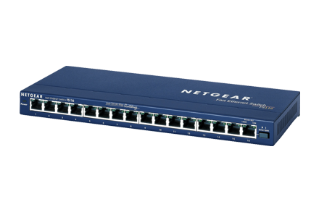

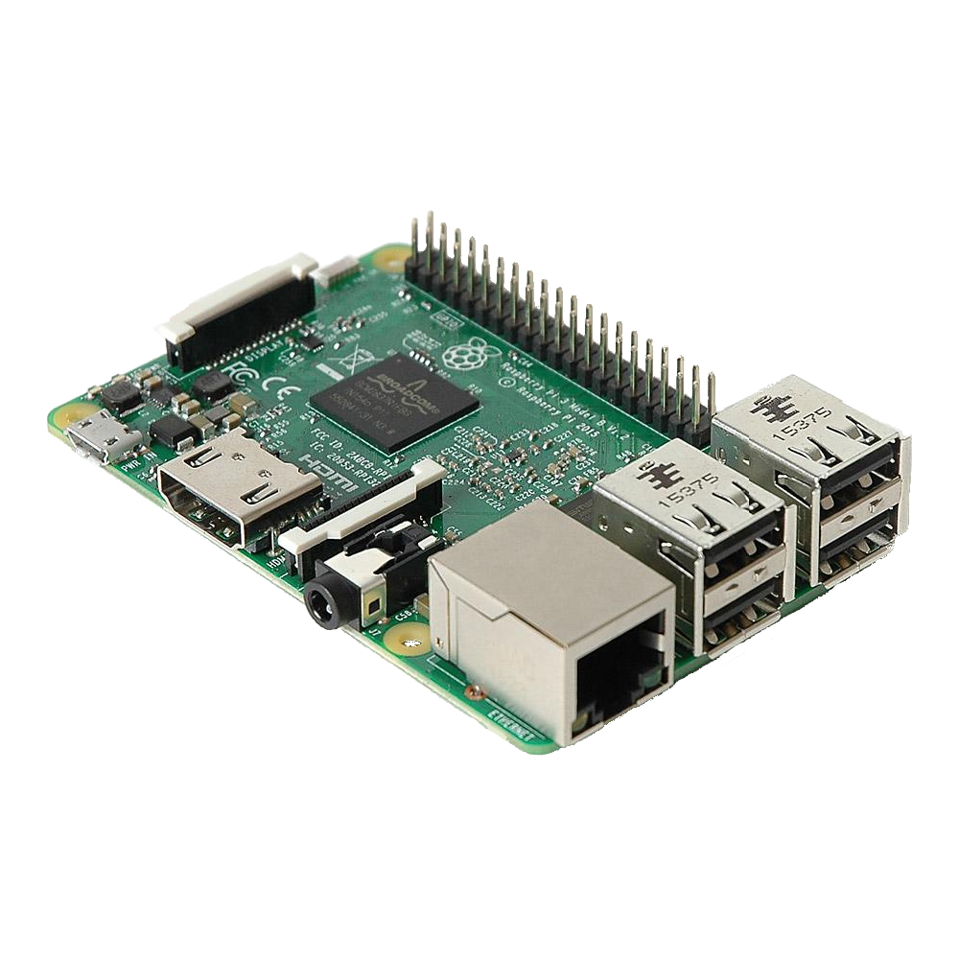


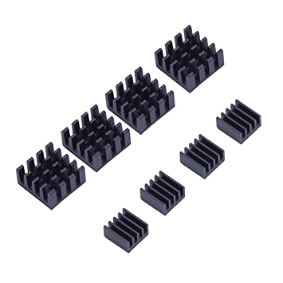
Supplies
Raspberry Pi 3, Model B (x8)
Micro SD Card (x8)
Micro-USB Power Cables (x8)
USB Power Block (x1)
16-Port Switch (x1)
Heatsink (x8)
Notes:
Bob

Slide 7
Cost of Supplies
Part | Quantity | Individual Cost | Total Cost
Samsung 32GB Evo Plus UHS-1 microSDHC | 8 | $16.99 | $135.92
Sabrent 60W 10-port USB Fast Charger | 1 | $32.99 | $32.99
Netgear ProSAFE 16-Port 10/100 Desktop Switch (Model no. FS116) | 1 | $52.62 | $52.62
Sabrent USB 2.0 A Male to Micro B 1 ft. Cables (6 pack) | 2 | $7.99 | $15.98
Raspberry Pi 3, Model B, 1GB RAM | 8 | $35 | $280
Mudder 8 Piece Black Aluminum Heatsink | 2 | $6.79 | $13.58
Total Cost: |  |  | $531.09
Notes:
Bob

Slide 8
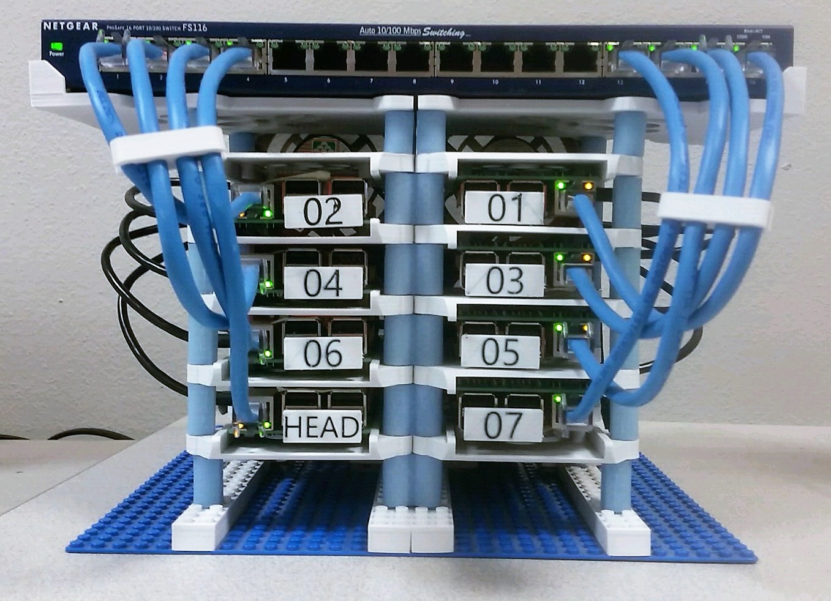
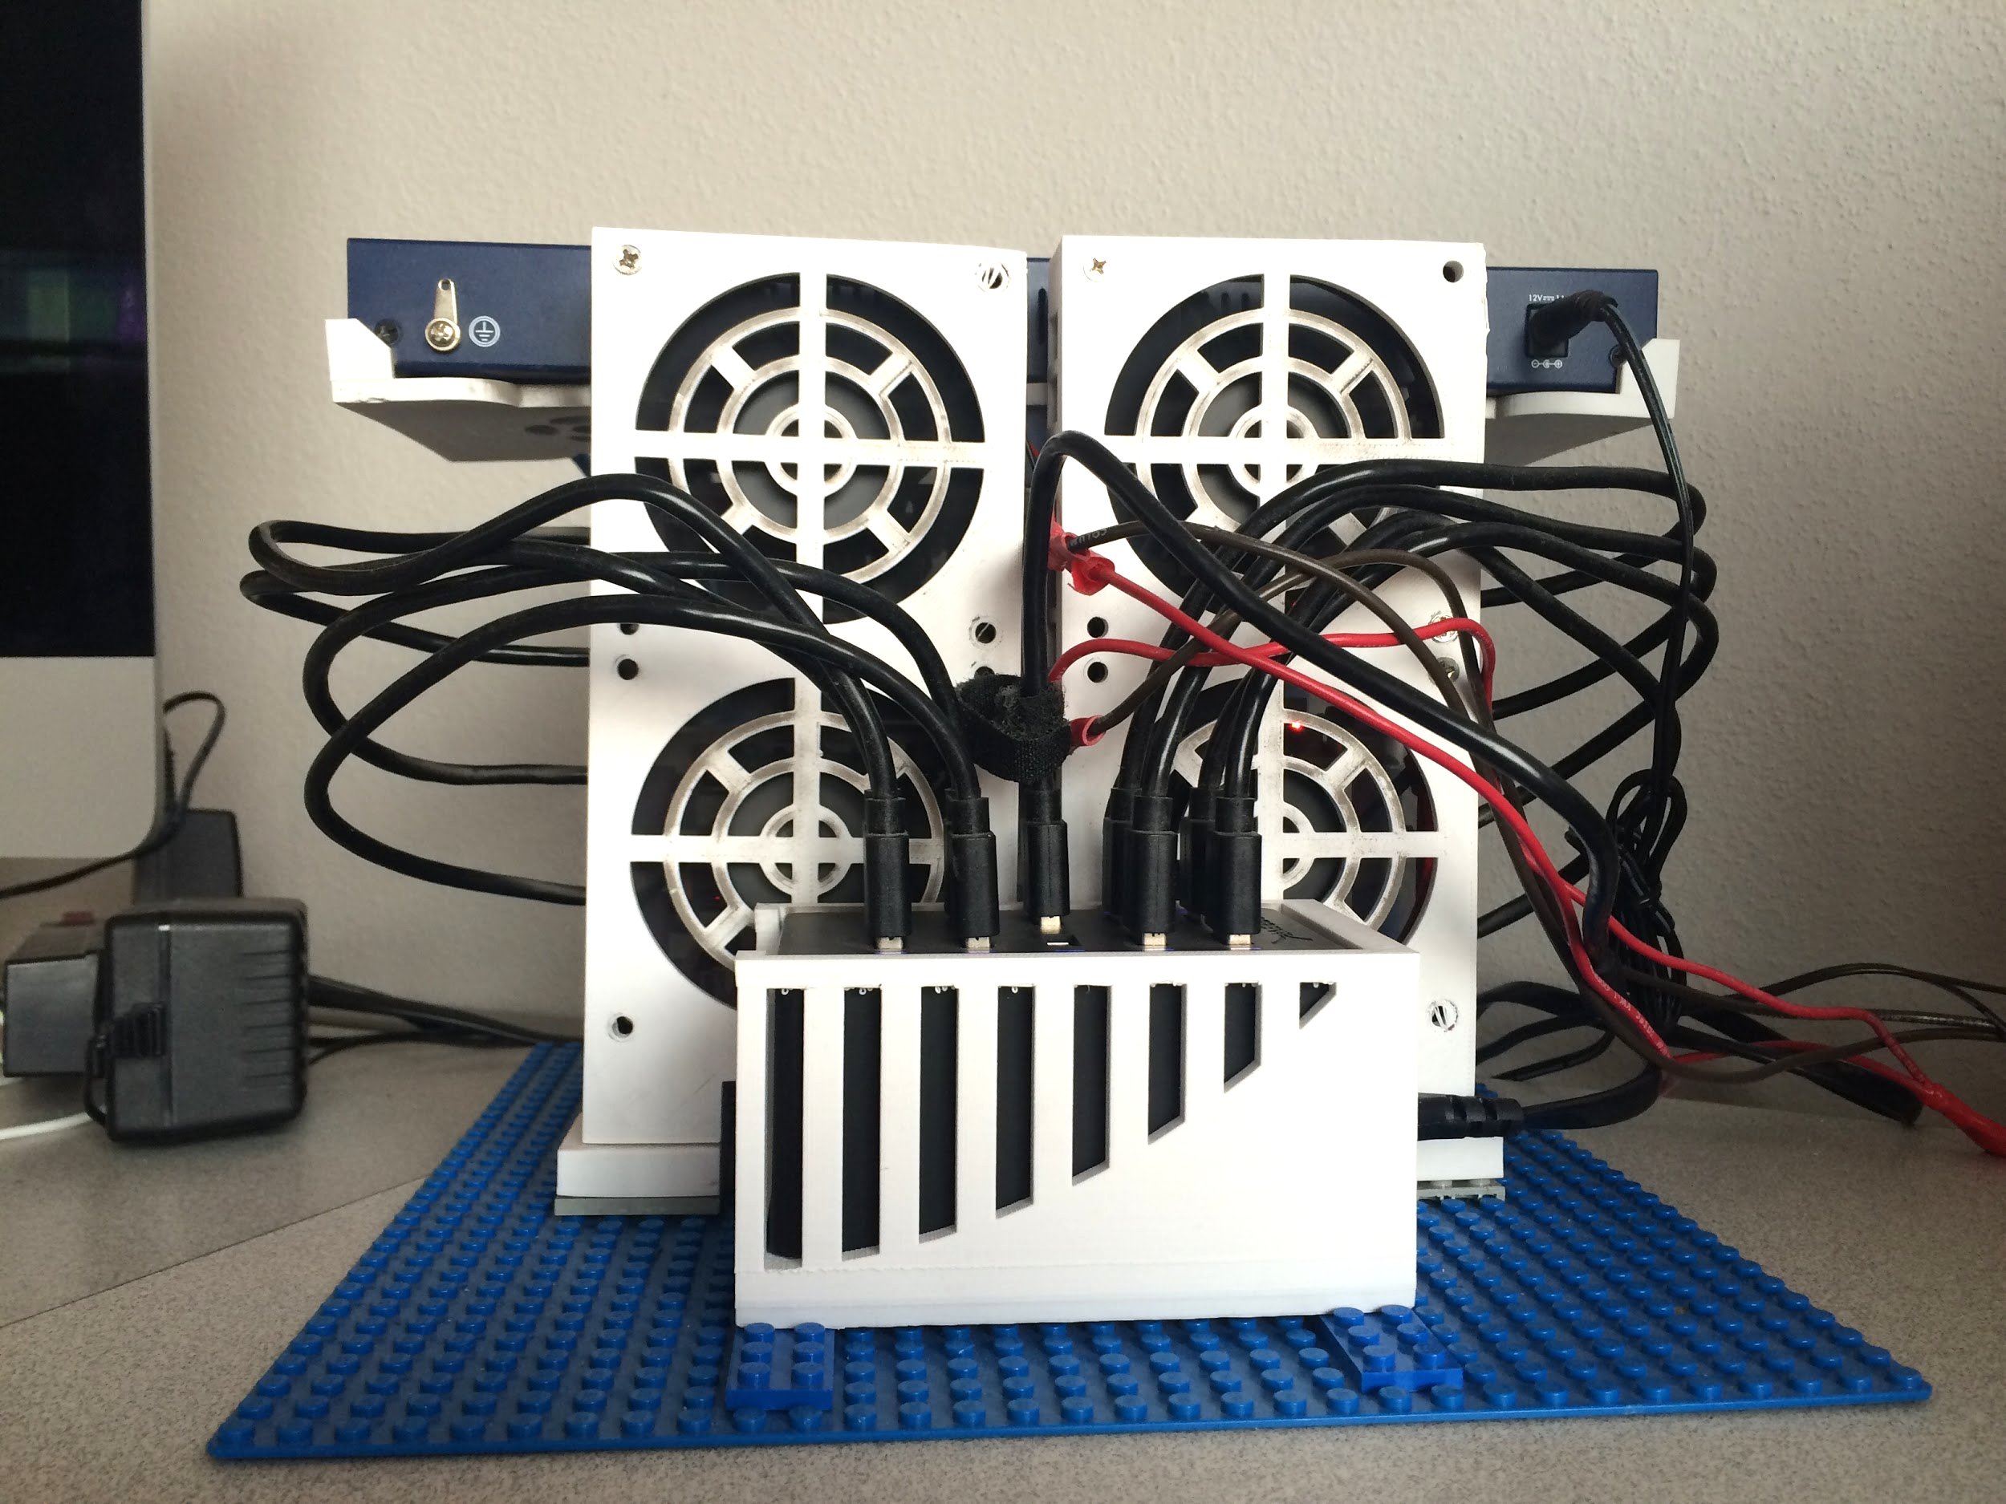
Hardware Setup
Notes:
Bob

Slide 9
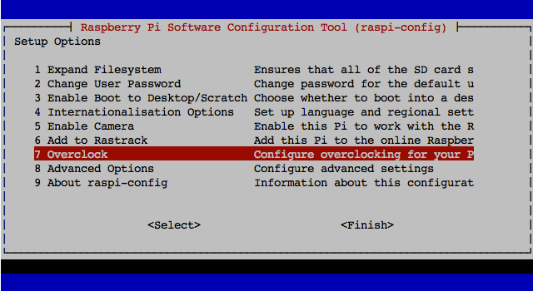
Software Setup
Full Raspbian Jessie on Head node
Raspbian Jessie Lite on the Slave nodes
Less overhead from the OS, more computing resources available
Did basic Raspberry Pi configuration on slave and master, copied the slave image to the rest of the SD cards
Notes:
Bob

Slide 10
Network Configuration
Connected each Pi to the master through an ethernet switch
Used eth0 interface for inter-Pi communication, wlan0 for access to internet
Wanted most reliable communication for parallel processing, internet access for downloads, SSH and updates
Set up master node as DHCP server to hand out IP addresses to slaves
Set up NAT to route all slave node traffic through master node
Wanted slaves to be able to reach the internet but on their own subnet
Exchange RSA keys between all Pis for password-less login
Notes:
Bob

Slide 11
Network Diagram
Notes:
Bob

Slide 12
Bash Scripting
Implemented several different bash scripts to facilitate our research
Parallel Terminals (DVTM)
Create files, execute commands on all Pis at once
New user script
Create a new user with parallel processing environment already set up
Copy Script
Copy files from one node to the same directory on every other node
Parallel SSH
Used to implement our own form message passing interface
Notes:
Greg

Slide 13
Parallel Processing Methods
Notes:
Greg

Slide 14
Single Process Across the Cluster
Notes:
Greg

Slide 15
Parallel Processing across the cluster
Notes:
Greg

Slide 16
Message Passing Interface (MPI)
Well-known standard for parallel processing used in high performance computing implemented in several languages
Has implementations in C, C++, Python and Fortran
Message passing: the sharing of data between threads or processes
Same script runs on every node and messages with data are passed
Rank: every process has a unique integer ID assigned when the process initializes
Used to specify source and destination of messages passed
If rank = 0, do this; else if rank = 1, do this
Communication world: scope of the communication processes for ranks
MPI_COMM_WORLD is default, includes all nodes
Could specify number of processes to use
If more than physical nodes, uses multiprocessing
Notes:
Bob

Slide 17
Python Multiprocessing with PSSH
Python allowed us to implement parallel processing
Same concept as MPI
Master node executes script
PSSH into each slave node, executes same script
Each node returns their calculations to the master node
Master node performs calculation of Pi
Only message passing at the beginning and end of script execution, saw similar performance to MPI
Notes:
Greg

Slide 18
Testing
Notes:
Bob

Slide 19
Monte Carlo Method
Monte Carlo methods are numerical methods which solve a problem by generating suitable random numbers and observing that fraction of the numbers obeying some property
Allow for easy parallelization
Implemented a Monte Carlo calculation of Pi
Generate n random (x, y) points within a 2x2 square, observe the fraction of points within a circle of radius 1
Multiply this fraction by the area of the square, obtain our approximation
In general, as n grows, the accuracy of the approximation increases
Notes:
Bob

Slide 20
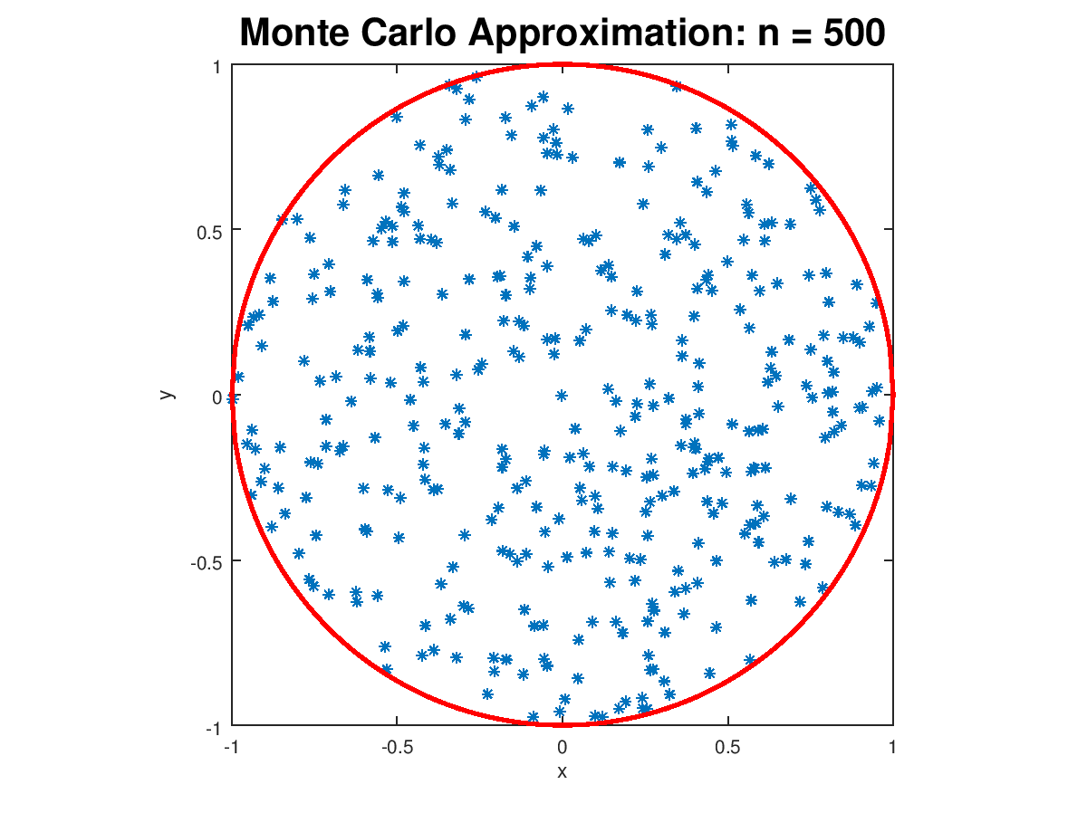
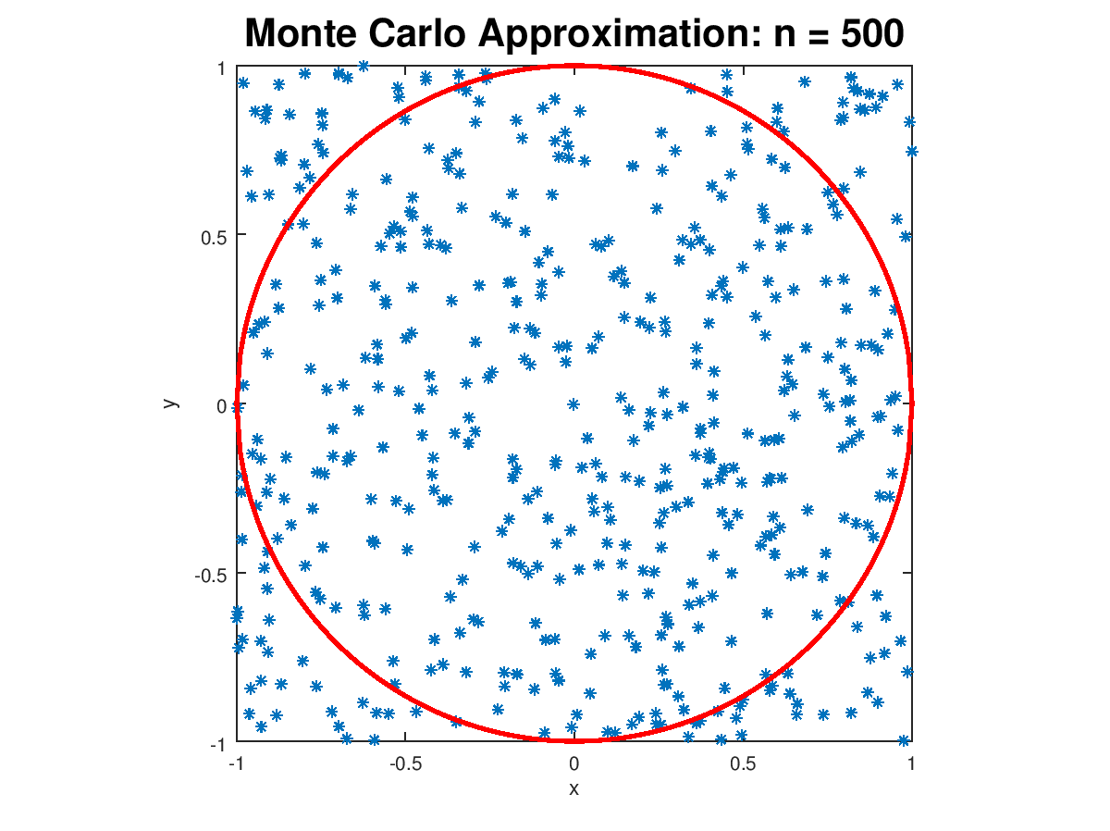
Monte Carlo Method Cont.
function calculate_pi(n)
integer circle, index
real x, y, pi_approx
circle ← 0
for index = 0 to n
x ← (2 * random() - 1)
y ← (2 * random() - 1)
if( x² + y² <= 1)
circle ← circle + 1
end if
end for
pi_approx ← (circle / n) * 4
return (pi_approx)
end function
Notes:
Bob

Slide 21
Raspberry Pi and Desktop Specs
Raspberry Pi 3 Model B
Processor: 4x ARM Cortex-A53, 1.2GHz
RAM: 1 GB LPDDR2-900 SDRAM
Network:
10/100 MBPS Ethernet
802.11n Wireless LAN
OS: Raspbian
Desktop
Processor: Intel i7-2600K (8) @ 3.4GHz
RAM: 32GB DDR3 1600 MHz
OS: Windows 10
Notes:
Greg

Slide 22
Performance Testing
Cluster
Ran all tests with 8 nodes
Each node run with one to four processes
Two different parallel processing implementations
PSSH with Python multiprocessing
MPI
Desktop
One through eight processes (eight core processor)
Used multiprocessing because only one machine
Notes:
Greg

Slide 23
Results
Notes:
Bob

Slide 24
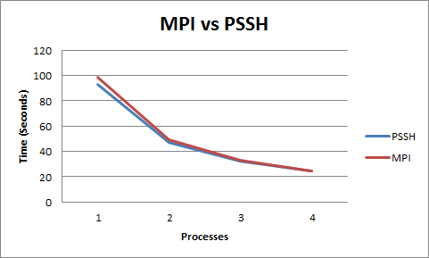
Cluster Results
Graph shows average runtime of all tests for different numbers of processes per node
Since we were only transferring single values, our PSSH is effectively the same as MPI, at runtime n
Only messages passed were number of points for node to calculate at beginning and fraction returned at the end
We hypothesize that MPI would make more of a difference with bigger data transfers between nodes
Notes:
Bob

Slide 25
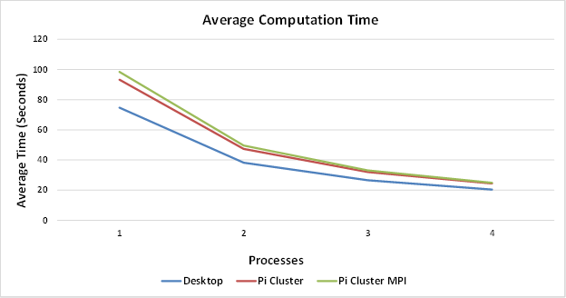
Cluster vs. Desktop Results
Very surprised how close the cluster compared to the desktop
Desktop had 4 physical cores and 4 logical cores
Saw little improvement by adding logical cores
Our most accurate approximation of Pi was 3.141598027 from PSSH with multiprocessing with 4 processes per node on cluster with 1 billion points
Accurate to 10^-5
Notes:
Bob

Slide 26
Conclusion
Notes:
Bob

Slide 27
Challenges We Encountered
Setting up the NAT, other network configuration
Bad Wi-Fi module on two Pis
Setting up MPI for C and Python
Coding with MPI framework
Designing custom 3D printed case
Making it work with our 3D printer, designing Legos
Notes:
Bob

Slide 28
Further Research
Implement different parallelizable algorithms on our cluster with more message passing
Determine if 10/100 ethernet becomes bottleneck
Implement algorithms in C, see if there is a performance difference
Add more nodes
Look into other parallel frameworks we could implement
Collaboration with local colleges: Macalester, St. Olaf
Notes:
Drew

Slide 29
Questions?
Notes:
Drew

